Slide 1


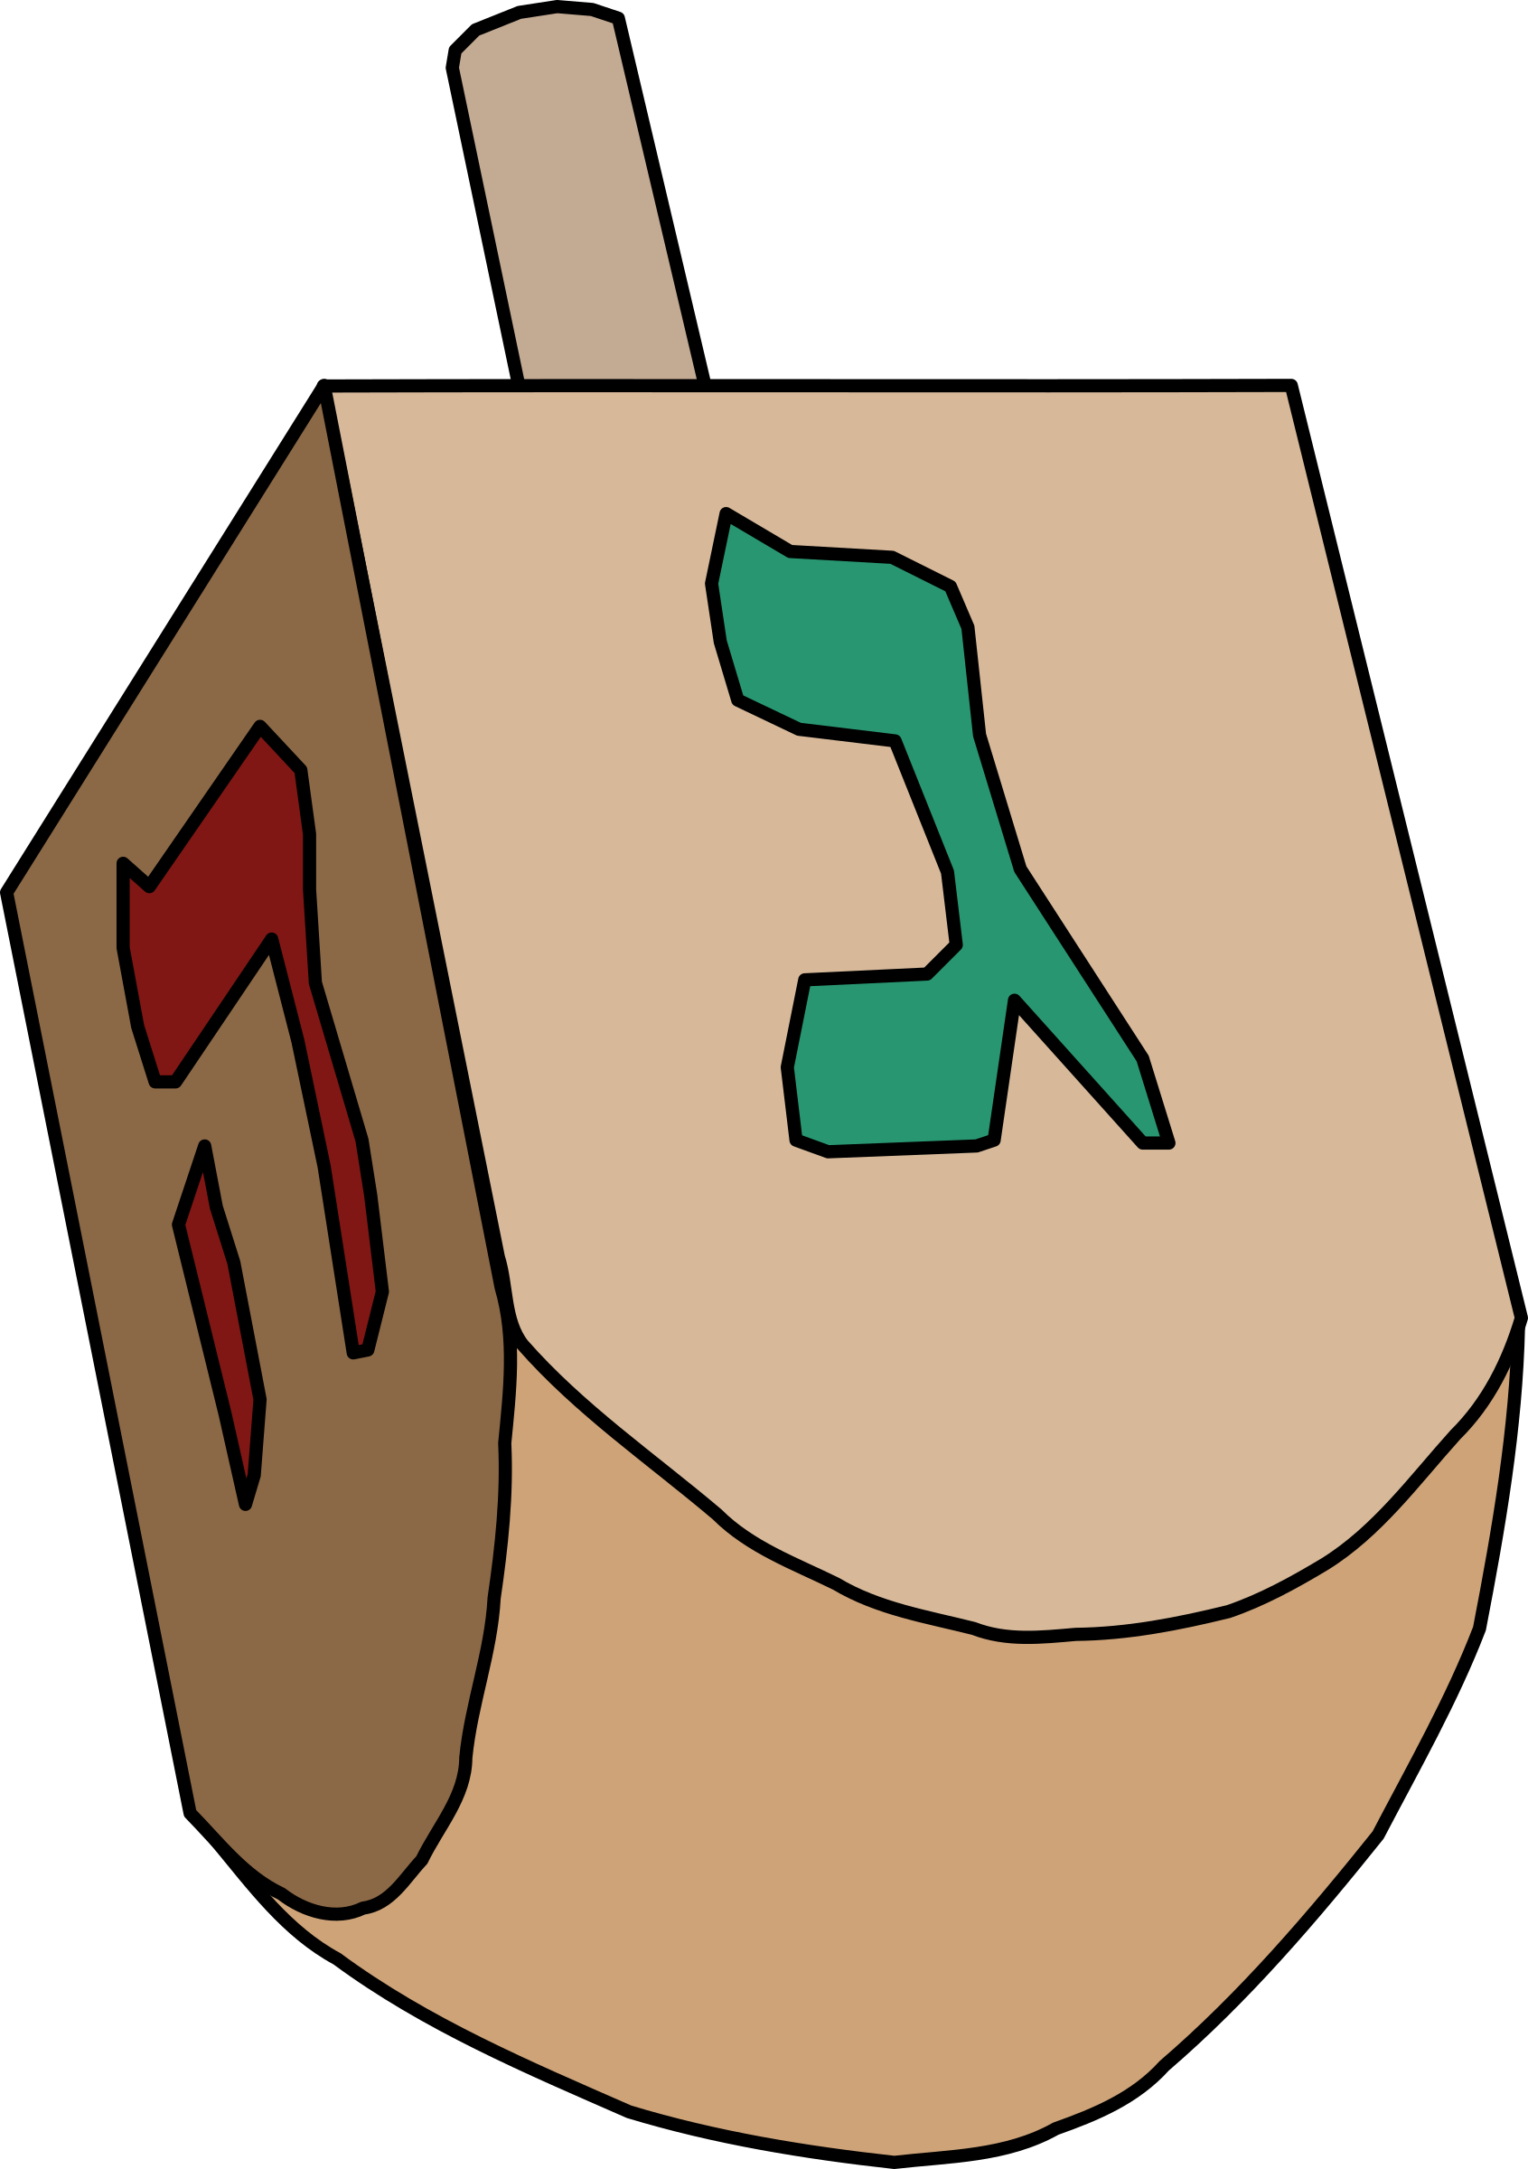
December Holidays
CUDAP Sign Choir
11/30/17

Slide 2

Word List
Angel
Candle
Celebrate
Christmas
December
Donkey
Dreidel
Hanukkah
Holiday
Jesus
Kwanzaa
New
Year
Night (New Years Eve)
Noise
Santa Claus
Star
Tree

Slide 3
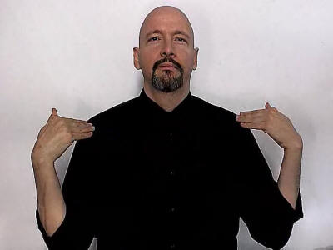
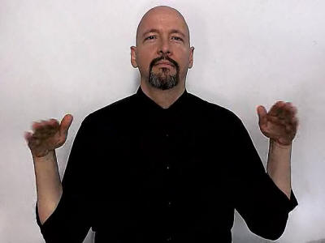
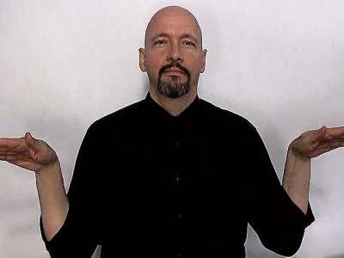
Angel
DESCRIPTION: Brush your shoulders with flat hands, as if showing off your wings
Back to Word List

Slide 4
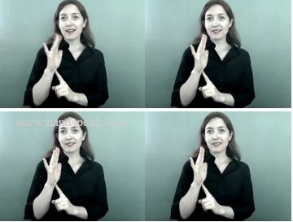
Candle
DESCRIPTION: Rest right flat hand on left 1 hand; wiggle right fingers, like a candle flickering
Back to Word List

Slide 5
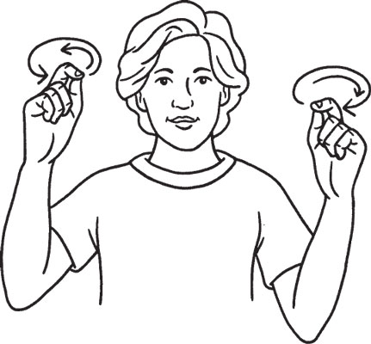
Celebrate
DESCRIPTION: Move two X hands in small circles, as if spinning noise makers on New Years
Back to Word List

Slide 6
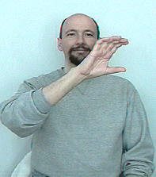
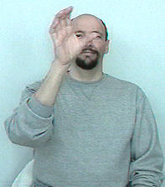
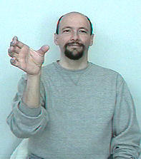
Christmas
DESCRIPTION:
With a C hand, draw the shape of a wreath
Back to Word List

Slide 7


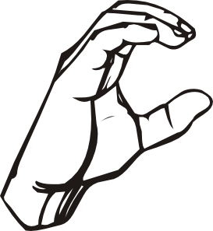
December
DESCRIPTION: Fingerspell D-E-C
Back to Word List

Slide 8
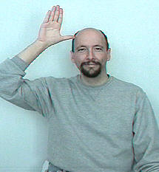
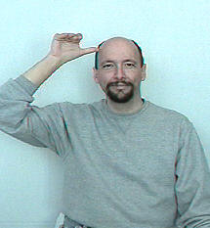
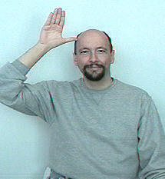
Donkey
DESCRIPTION: Touch right flat hand to forehead and bend fingers twice
Back to Word List

Slide 9
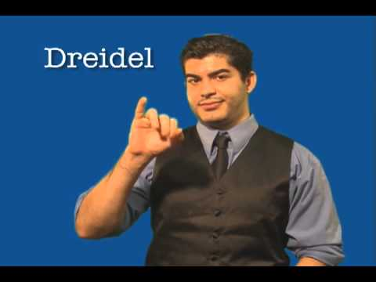
Dreidel
DESCRIPTION: Brush your middle finger against your thumb, as if spinning a dreidel
Back to Word List

Slide 10
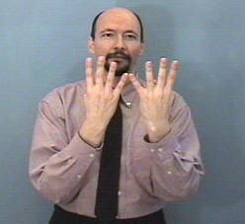
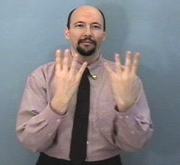
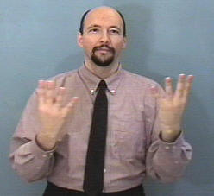
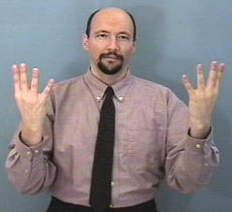
Hanukkah
DESCRIPTION: Hold two 4-hands with pinkies touching, then move them apart
Back to Word List

Slide 11
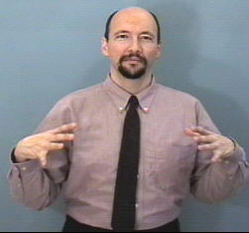
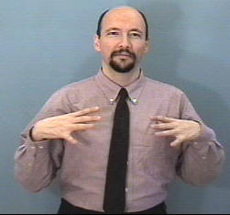
Holiday
DESCRIPTION:
With fingers spread out, tap thumbs against chest twice
Back to Word List

Slide 12
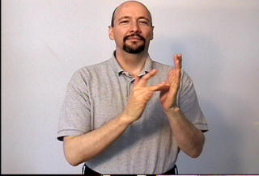
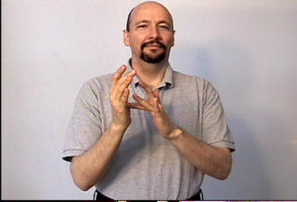
Jesus
DESCRIPTION: Touch your left palm with right middle finger, then right palm with left middle finger
Back to Word List

Slide 13
Kwanzaa
DESCRIPTION: Hold two 1-hands together, then change to 3-hands as you move them apart
Back to Word List

Slide 14
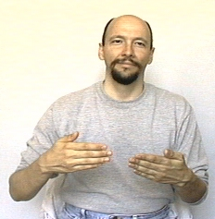
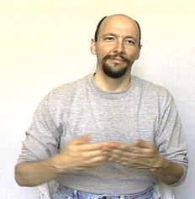
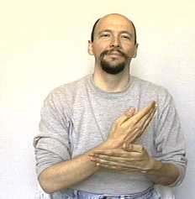
New
DESCRIPTION: Brush right hand against left palm and up towards your left shoulder
Back to Word List

Slide 15
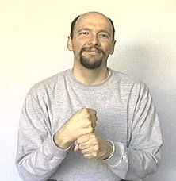
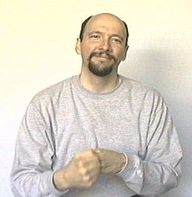
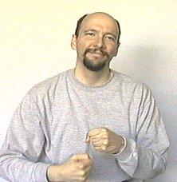
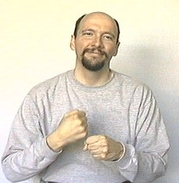
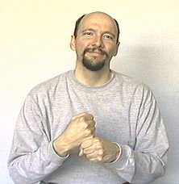
Year
DESCRIPTION: Make a circle around left fist using right fist
Back to Word List

Slide 16
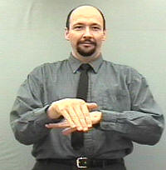
Night
DESCRIPTION: Rest right arm on top of left
NEW+YEAR+NIGHT = New Years Eve
Back to Word List

Slide 17
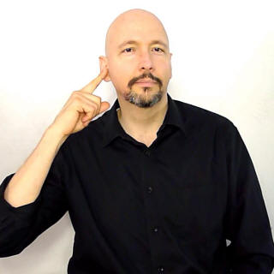
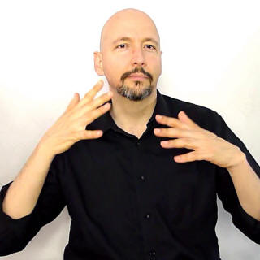
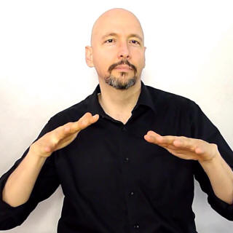
Noise
DESCRIPTION: Touch ear with right hand, then shake both flat hands twice
Back to Word List

Slide 18
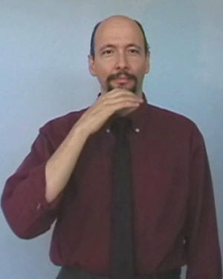
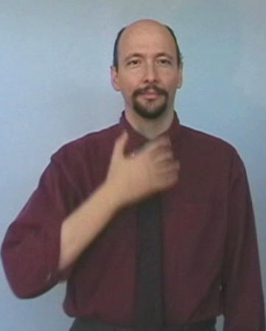
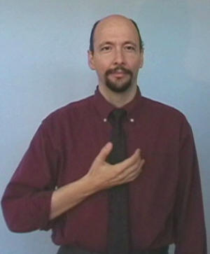
Santa Claus
DESCRIPTION: With a relaxed C hand, show the shape of Santa’s beard
Back to Word List

Slide 19
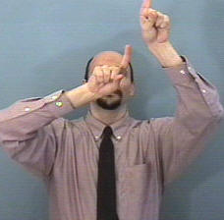
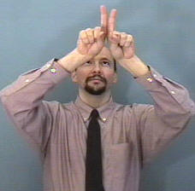
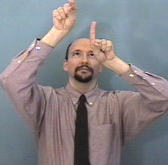
Star
DESCRIPTION: Brush 1-hands against each other, like you’re pointing at at stars high above
Back to Word List

Slide 20
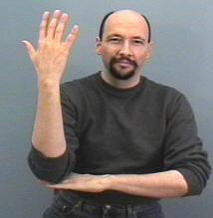
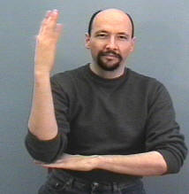
Tree
DESCRIPTION: Rest vertical right arm on horizontal left arm. Twist right hand twice
Back to Word List

Slide 21
Questions?

Slide 22
Want to Learn More?
Hanukkah/Jewish Signs: http://jewishdeafmm.org/jewish-signs-glossary/#!prettyPhoto
Christmas Signs: https://www.signingsavvy.com/wordlist/3351/christmas%20words

